Slide 1
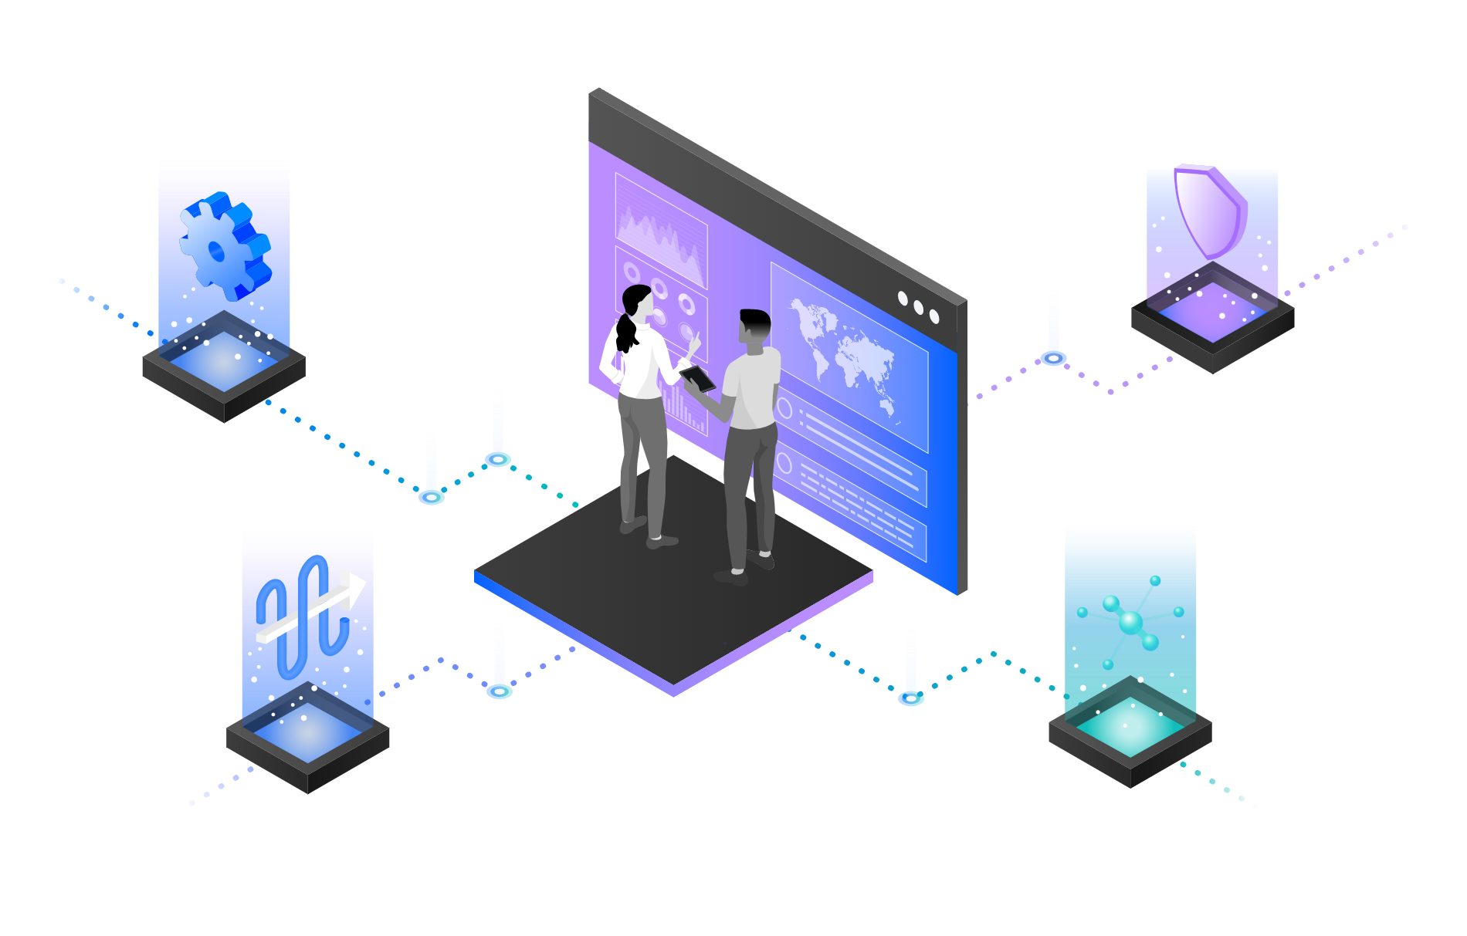
IBM Cloud Pak for Integration – IBM MQ
Create, Manage, Secure and Socialize GraphQL APIs with IBM API Connect and API Connect Essentials
—
Brian Wilson Americas Principal Automation Technical Sales Leader
Rafael Osorio Senior, Learning Content Development, Automation Software
Notes:
Today we will demonstrate This demo will walk you how to create, manage, secure and socialize GraphQL APIs with IBM API Connect and API Connect Essentials.

Slide 2
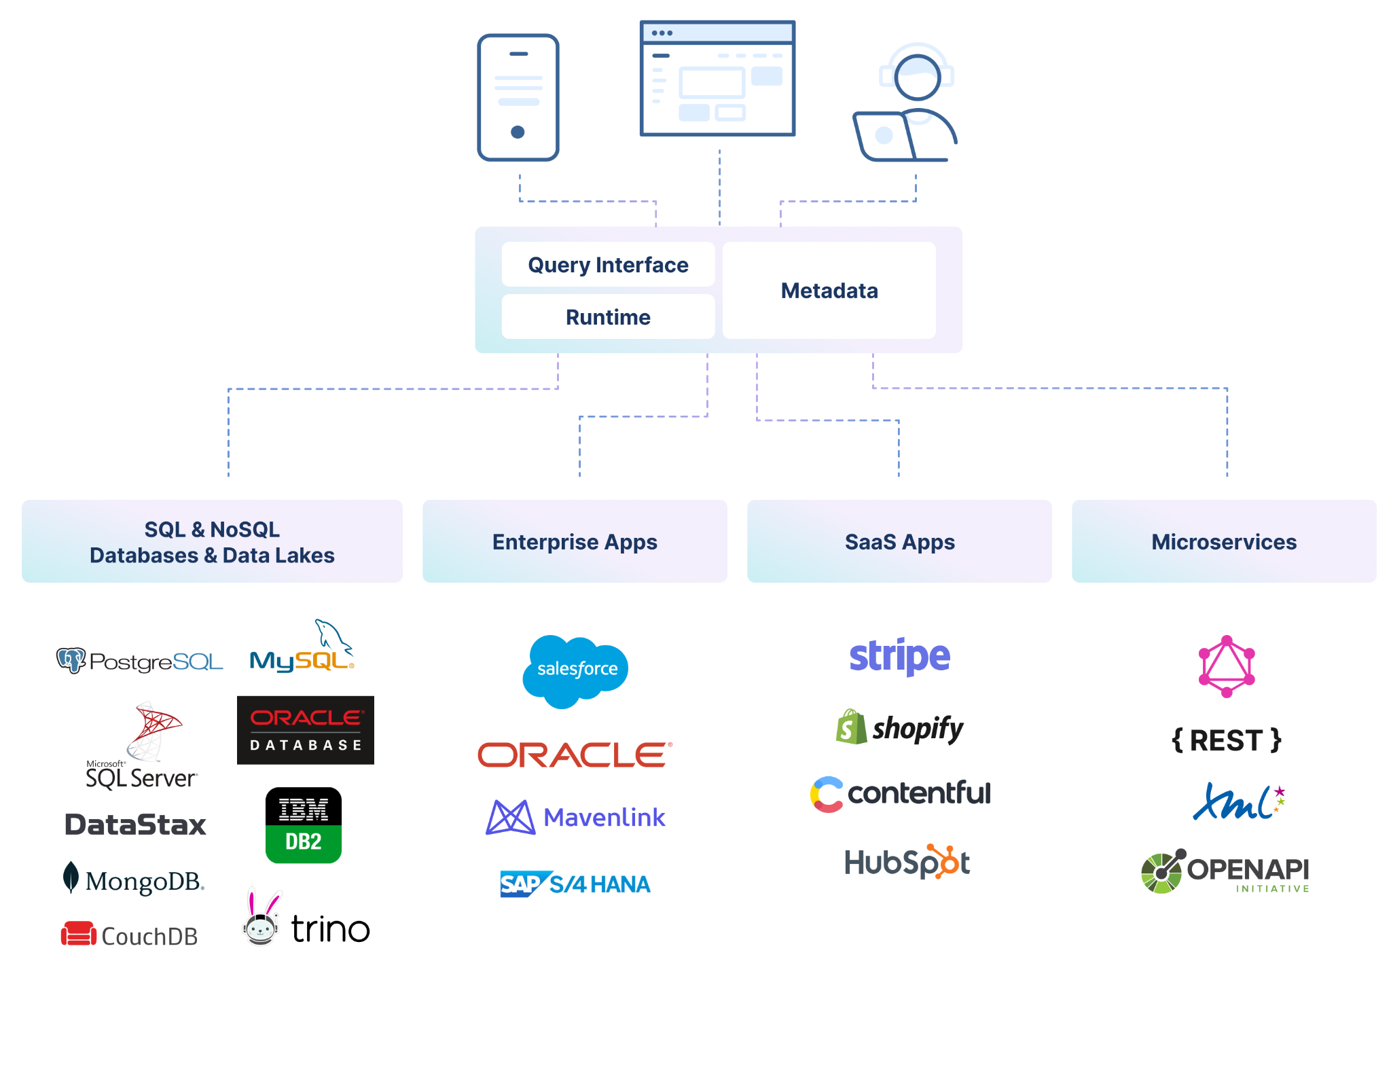
The rising adoption of hybrid cloud has resulted in data stored everywhere
How to access diverse, complicated silos?
?
Notes:
The rising adoption of hybrid cloud has resulted in data stored everywhere – in different types of data stores likes data warehouses, lakes, and lakehouses as well as across different clouds and on-premises environments. APIs serve as the essential connector between different data sources and applications, which means that businesses are relying on and creating more APIs than ever before to get the data they need to power their applications and experiences. GraphQL has rapidly become a go-to query language for companies to interact with their data and is emerging as a new standard for APIs, layering upon the investments in REST APIs and data systems. While GraphQL APIs are significantly easier for the application teams to consume, they can represent a challenge to the API Provider teams tasked with building them. We believe that APIs built declaratively are simply better - leading to first implementation with fewer lines of clean code, faster time to deploy, and APIs with built-in performance, cost, and reliability optimizations.

Slide 3
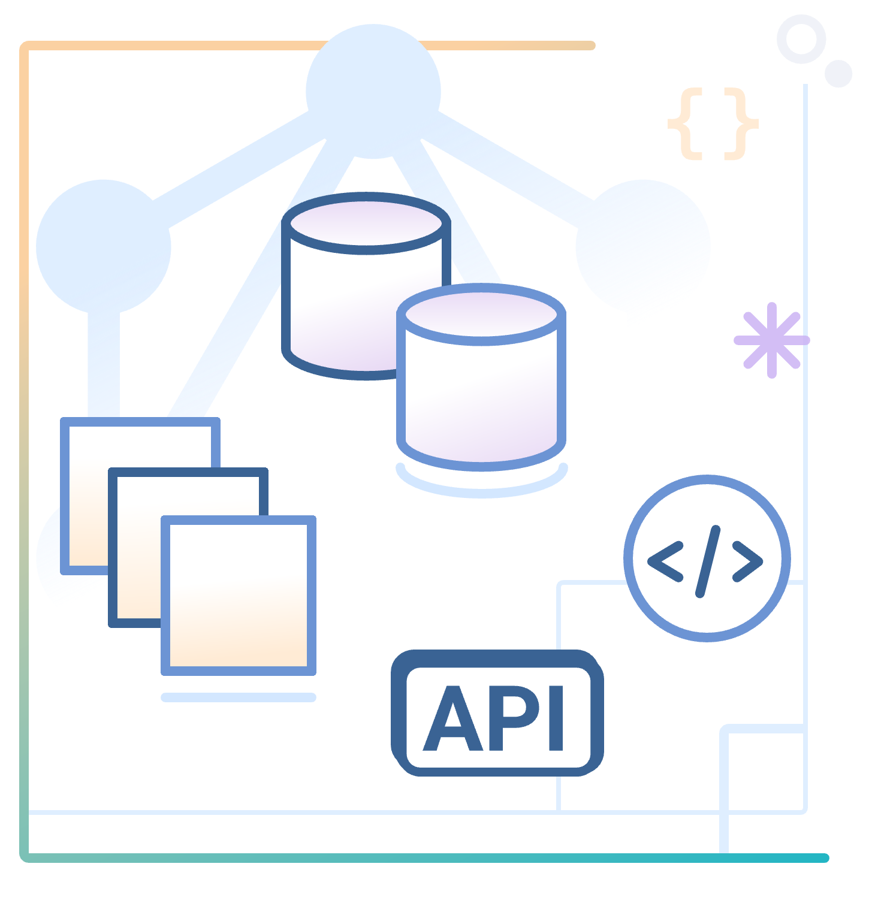
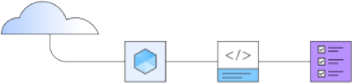
Focus Corporation Scenario
Hypothetical retail company that wants to derive more revenue from first-time customers to their online storefronts.
Focus development team decided to invest in GraphQL as a new standard for APIs.
Focus’ developers would like to explore an easier way for developers to build GraphQL APIs, consuming data stored everywhere. They would like to explore a way to create GraphQL APIs using a declarative approach for federated access to data.
Focus’ team would like to learn how to CREATE, MANAGE, SECURE and SOCIALIZE their GraphQL APIs.
Notes:
Focus Corporation, a hypothetical retail company engaged with IBM, is highly motivated to derive more revenue from first-time customers to their online storefronts. Focus development team decided to invest in GraphQL as a new standard for APIs. GraphQL is a query language for APIs that gives an application client greater control over what data it retrieves in an API request when compared with a REST API request. Focus’ developers would like to explore an easier way for developers to build GraphQL APIs, consuming data stored everywhere. While GraphQL APIs are significantly easier for the application teams to consume, they can represent a challenge to the API teams tasked with building them, securing them, socializing them, and managing them. To ease the process of building these APIs, they would like to explore a way to create GraphQL APIs using a declarative approach for federated access to data. Focus’ team requested a demo to learn how to move from zero to enterprise in the GraphQL API domain. The following demo, Focus’ developers will learn how to use API Connect Essentials (StepZen) to create a a federated GraphQL API by pulling data from disparate sources (REST API and MySQL). After that they will use IBM API Connect to create a GraphQL API proxy definition that proxies a backend GraphQL server from StepZen, and to define rate limiting controls that reflect the amount of data that is returned from the server. In this demo, Focus will see how to CREATE, MANAGE, SECURE and SOCIALIZE their GraphQL APIs using IBM API Connect solution.

Slide 4
Demonstration Agenda
09
9 - Socialize your API
08
8 - Create a Product and apply GraphQL RateLimits
07
7 - Edit and Test the GraphQL Proxy API
06
6 - Create a GraphQL Proxy API in APIC
05
5 - Create a composition of building blocks using @materializer
04
4 - Autogenerate GraphQL Schemas from MySQL Database
03
3 - Add a new REST API in the GraphQL API
02
2 - Build a GraphQL API from a REST API
01
1 - Setup API Connect Essentials (StepZen)
Notes:
In the demo we will execute the following steps:
Setup API Connect Essentials;
Build a GraphQL API from a REST API
Adding a new REST API in the GraphQL API
Autogenerate GraphQL Schemas from MySQL Database
Creating a composition of building blocks using @materializer
Create a GraphQL Proxy API in APIC
Edit and Test the GraphQL Proxy API
Create a Product and apply GraphQL RateLimits
Socialize your API
Let’s get started!

Slide 5
Demonstration
Notes:
See script documentation for assistance in demo execution

Slide 6
Demonstration Summary
In this demo, the Focus’ team:
Created a GraphQL API using a declarative approach using API Connect Essentials (StepZen);
Created a GraphQL API using different sources (two REST services and one MySQL database);
Created a graph composition using @materializer;
Deployed the new GraphQL API on StepZen Cloud runtime;
Created a GraphQL Proxy API in API Connect to call the GraphQL API on StepZen;
Managed their API and set up the security policies;
Create a Product and apply GraphQL rate limits;
Socialize their GraphQL API on Developer Portal and demonstrated how an API consumer can use the API portal to perform self-service consumption of the API;
From a business perspective, Focus Corporate learned how to use APIs to automate a series of steps to obtain customer and order information from different sources (legacy services and databases). They verified how to use API as the foundation of their digital transformation journey.
For Focus’ Development team, they learned an easier way to build GraphQL APIs and consume data stored everywhere. At the same time, they saw a complete API Management solution that enables them to create, secure, socialize and manage APIs.
Notes:
Let’s summarize what Focus’ developers have done today. In this demo they:
Created a GraphQL API using a declarative approach using API Connect Essentials (StepZen);
Created a GraphQL API using different sources (two REST services and one MySQL database);
Created a graph composition using @materializer;
Deployed the new GraphQL API on StepZen Cloud runtime;
Created a GraphQL Proxy API in API Connect to call the GraphQL API on StepZen;
Managed their API and set up the security policies;
Create a Product and apply GraphQL rate limits;
Socialize their GraphQL API on Developer Portal and demonstrated how an API consumer can use the API portal to perform self-service consumption of the API;
From a business perspective, Focus Corporate learned how to use APIs to automate a series of steps to obtain customer and order information from different sources (legacy services and databases). They verified how to use API as the foundation of their digital transformation journey. For Focus’ Development team, they learned an easier way to build GraphQL APIs and consume data stored everywhere. At the same time, they saw a complete API Management solution that enables them to create, secure, socialize and manage APIs.

Slide 7
Thank you
© Copyright IBM Corporation 2024. All rights reserved. The information contained in these materials is provided for informational purposes only and is provided AS IS without warranty of any kind, express or implied. Any statement of direction represents IBM’s current intent, is subject to change or withdrawal, and represent only goals and objectives. IBM, the IBM logo, ibm.com and IBM Automation are trademarks of IBM Corp., registered in many jurisdictions worldwide. Red Hat® and OpenShift® are trademarks or registered trademarks of Red Hat, Inc. or its subsidiaries in the United States and other countries. Other product and service names might be trademarks of IBM or other companies. A current list of IBM trademarks is available at Copyright and trademark information.
7
Notes:
Thank you for attending today’s presentation.

Slide 8
8

Slide 9
Backup Slides

Slide 10


IBM Cloud Pak for Integration
Client & Partner Applications
Shared asset
repository
Unified governance framework
API management
Application integration
End-to-end security
Enterprise messaging
Event streaming
High speed data transfer
AI and machine learning
Robotic Process Automation
Natural language interactions
Process mining
Event detection
Machine learning
3rd Party integrations
Operational models
IBM Automation foundation
Robotic Process Automation
Natural language interactions
Process and task mining
Event detection
Machine learning
3rd Party integrations
Operational models
IBM Cloud
AWS
Microsoft Azure
Google Cloud
VMware
Private
IBM Z IBM LinuxOne IBM Power Systems
End points
IBM Integration / © 2021 IBM Corporation
10
Notes:
NOTE: Use this slide if you want to give a product overview and describe the capabilities presented in this demo.
IBM Cloud Pak for Integration is a hybrid integration platform with an automated, closed-loop approach that supports multiple styles of integration within a single, unified experience. This Demo demonstrates how Cloud Pak for Integration automates customer interactions using APIs and Integration. In this demo, you will see the API Management, Application Integration and End-to-end security capabilities in action.

